Slide 1
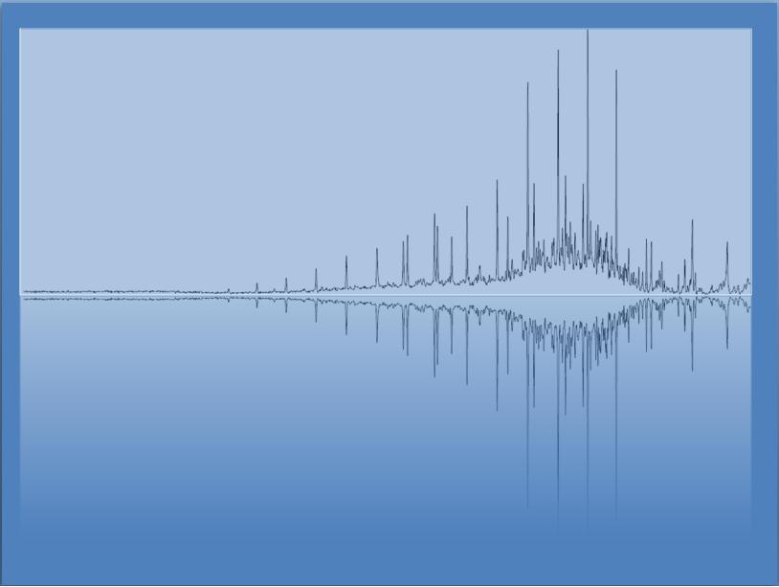
Chemical Reactions
Chem 3A- Yates

Slide 2
Steps to Complete a Chemical Equation
0. If Ionic Compounds Present, Break apart ions.
Predict Products
Think about reaction types “Scheme 1” (DD, SD, Combination, Decomposition)
Make sure you write correct formulas of products.
Balance Equation
Predict States (‘aq’ or ‘s’? Don’t forget Gas Evol)
Determine Reaction Type from “scheme 2”
(If necessary) Write Complete and Net Ionic Equations.

Slide 3
Lecture 7: Outline
Determining the Products of the reaction
Determining States
Balancing Chemical Equations
“Types” of Chemical Reactions
Net Ionic Equations

Slide 4
Determining Products Try to identify the category from below
Combination
A + B → AB
Decomposition
AB → A + B
Single Displacement
AB + C → CB + A
Double Displacement
AB + CD → CB + AD
C(s)+ O₂(g) → ?
2 NaCl(s) → ?
2 AgCl(aq) + Cu(s) → ?
NaCl(aq) + AgNO₃(aq) → ?

Slide 5
Determining Products Complete the products according to category
Combination
A + B → AB
Decomposition
AB → A + B
Single Displacement
AB + C → CB + A
Double Displacement
AB + CD → CB + AD
C(s)+ O₂(g) → CO₂(g)
2 NaCl(s) → 2 Na(s) + Cl₂(g)
2 AgCl(aq) + Cu(s) →
CuCl₂(aq) + 2 Ag(s)
NaCl(aq) + AgNO₃(aq)→
AgCl(s) + NaNO₃(aq)

Slide 6
Determining Products *Highlight - Combustion
Combustion is a type of combination reaction, when a substance reacts with oxygen (O₂).
When a hydrocarbon burns, the products are always CO₂ and H₂O.
When a Metal burns, thee product is a metal oxide.
2 C₂H₆O₂(g) + 5 O₂(g) → 4 CO₂(g) + 6 H₂O(g)
4 Al(s) + 3 O₂(g) → 2 Al₂O₃(s)

Slide 7
Lecture 7: Outline
Determining the Products of the reaction
Determining States
Balancing Chemical Equations
“Types” of Chemical Reactions
Net Ionic Equations

Slide 8
Determining States in a Rxn
Elements
Metals: Solid (except Hg)
Non-Metals: Look it up
Molecular Compounds: Look it up (for now)
Ionic Compounds: Solid
Ionic Compounds in Water: Solid or Aqueous (Look up on Solubility Chart)*
*Na⁺, K⁺, NH₄⁺, and NO₃⁻ are always soluble
*Ag⁺ and high charge combos are usually insoluble

Slide 9
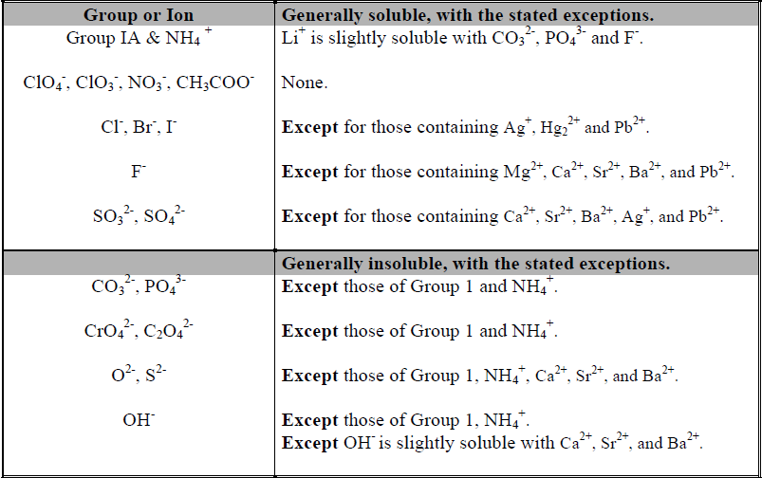
Solubility Table

Slide 10
Determining States- Gas Evolving Rxn
*memorize
Some Double displacement reactions form the Gas H₂S
Others, form a product that will decompose into H₂O and a gas.
H₂CO₃(aq) → H₂O(l) + CO₂(g)
H₂SO₃(aq) → H₂O(l) + SO₂(g)
NH₄OH(aq) → H₂O(l) + NH₃(g)

Slide 11
Lecture 7: Outline
Determining the Products of the reaction
Determining States
Balancing Chemical Equations
“Types” of Chemical Reactions
Strong Electrolytes and Dissociation
Net Ionic Equations

Slide 12
Seth’s Tips
Start with the easiest elements to balance.
If there is a polyatomic ion on both sides, treat it as one thing.
If you can balance with halves, do it, then multiply every coefficient by 2.
Acid-Base reactions combine H⁺ with OH⁻ to make H₂O. Just make sure there are the same number of H⁺, OH⁻, and H₂O present and you will be done.

Slide 13
Write Balanced Chemical Equations
MgCl₂(aq) + K₂S (aq) →
K₂CO₃(aq) + HCl(aq) →

Slide 14
Write Balanced Chemical Equations
CaCl₂(aq) + K₂S (aq) → 2 KCl(aq) + MgS(s)
K₂CO₃(aq) + 2 HCl(aq) → KCl(aq) + H₂O(l) + CO₂(g)

Slide 15
Write Balanced Chemical Equations
K₂SO₄(aq) + AgNO₃(aq) →
C₆H₁₄(l) + O₂(g) →
Al(OH)₃(aq) + H₂SO₄(aq) →

Slide 16
Write Balanced Chemical Equations
K₂SO₄(aq) + 2 AgNO₃(aq) → 2 KNO₃(aq) + Ag₂SO₄(s)
2 C₆H₁₄(l) + 19 O₂(g) → 12 CO₂(g) + 14 H₂O(l)
2 Al(OH)₃(aq) + 3 H₂SO₄(aq) → Al₂(SO₃)₃(s) + 6 H₂O(l)

Slide 17
Lecture 7: Outline
Determining the Products of the reaction
Determining States
Balancing Chemical Equations
“Types” of Chemical Reactions
Net Ionic Equations

Slide 18
Reaction Types
Double Displacement (“DD”)
Acid-Base/Neutralization
DD rxn between an Acid (H⁺) and a Base (OH⁻)
Gas Evolution
DD rxn that forms a Gas.
Precipitation
DD rxn that forms a Solid.
Others
RedOx (Oxidadation-Reduction) –covered in Ch 16
Gain or loss of electrons.
With ionic compounds, a metal will change charge.
Not “double displacement”
Combustion (A special type of RedOx)
Reaction w/ O₂ to form metal oxide (Al₂O₃) or non-metal oxide (CO₂).

Slide 19
Lecture 7: Outline
Determining the Products of the reaction
Determining States
Balancing Chemical Equations
“Types” of Chemical Reactions
Net Ionic Equations

Slide 20
Ionic Equations
Molecular equations- normal
2 KOH(aq) + Mg(NO₃)₂(aq) → 2 KNO₃(aq) + Mg(OH)₂(s)
Complete ionic equations- Show Dissociated as ions
Strong Acids and Aqueous Ionic are written as ions.
2K⁺(aq) + 2OH⁻(aq) + Mg²⁺(aq) + 2NO₃⁻(aq) → 2K⁺(aq) + 2NO₃⁻(aq) + Mg(OH)₂(s)
Net ionic equations- Eliminate what doesn’t change.
2OH⁻(aq) + Mg²⁺(aq) → Mg(OH)₂(s)

Slide 21
Practice–Write the Complete Ionic and Net Ionic Equations.
K₂SO₄(aq) + Ba(NO₃)₂(aq) → 2 KNO₃(aq) + BaSO₄(s)
Na₂CO₃(aq) + 2 HCl(aq) → 2 NaCl(aq) + CO₂(g) + H₂O(l)

Slide 22
Practice–Write the Ionic and Net Ionic Equation.
K₂SO₄(aq) + Ba(NO₃)₂(aq) → 2 KNO₃(aq) + BaSO₄(s)
2K⁺(aq) + SO₄²⁻(aq) + Ba²⁺(aq) + 2NO₃⁻(aq) → 2K⁺(aq) + 2NO₃⁻(aq) + BaSO₄(s)
Ba²⁺(aq) + SO₄⁻²(aq)→ BaSO₄(s)
Na₂CO₃(aq) + 2 HCl(aq) → 2 NaCl(aq) + CO₂(g) + H₂O(l)
2Na⁺(aq) + CO₃²⁻(aq) + 2H⁺(aq) + 2 Cl⁻(aq) → 2Na⁺(aq) + 2Cl⁻(aq) + CO₂(g) + H₂O(l)
CO₃⁻²(aq) + 2 H⁺¹(aq) → CO₂(g) + H₂O(l)

Slide 23
Practice–Write the Complete Ionic and Net Ionic Equations.
K₂SO₄(aq) + 2 NaNO₃(aq) → 2 KNO₃(aq) + Na₂SO₄(aq)
NaC₂H₃O₂(aq) + HCl(aq) → NaCl(aq) + HC₂H₃O₂ (aq)

Slide 24
Practice–Write the Ionic and Net Ionic Equation.
K₂SO₄(aq) + 2 NaNO₃(aq) → 2 KNO₃(aq) + Na₂SO₄(aq)
2K⁺(aq) + SO₄²⁻(aq) + 2 Na⁺(aq) + 2NO₃⁻(aq)
→ 2K⁺(aq) + 2NO₃⁻(aq) + 2 Na⁺(aq) + SO₄²⁻(aq)
No reaction
NaC₂H₃O₂(aq) + HCl(aq) → NaCl(aq) + HC₂H₃O₂ (aq)
Na⁺(aq)+ C₂H₃O₂⁻(aq) + H⁺(aq) + Cl⁻(aq)→ Na⁺(aq)+ Cl⁻(aq)+ HC₂H₃O₂ (aq)
C₂H₃O₂⁻(aq) + H⁺(aq) → HC₂H₃O₂ (aq)

